Slide 1

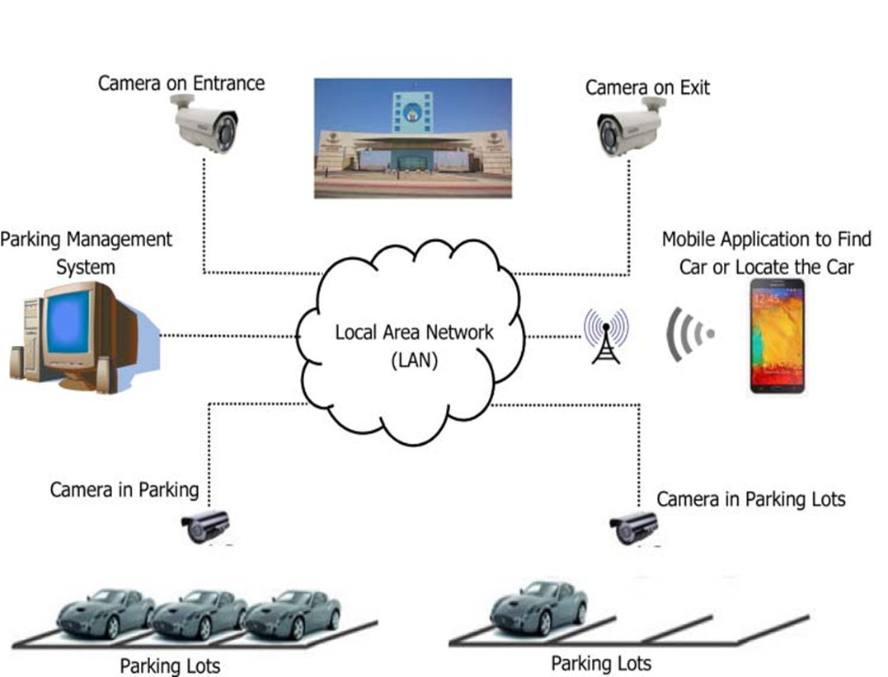
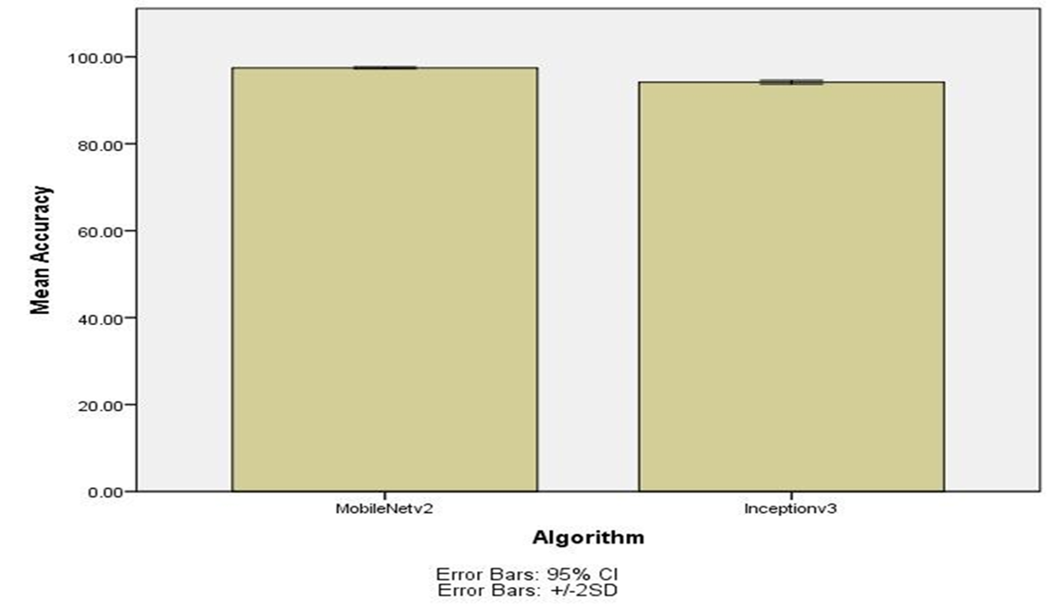
Name: N.S Lakshmi Charith Register Number: 192111138
Guided by Dr. S .Sankar
Ms. Poorani.S
Guided by Dr. Mary Valantina. G
Efficient Smart Parking System Using Inception-V3 Algorithm Comparing with MobileNet-V2 Algorithm
INTRODUCTION
Urban areas are grappling with a parking crunch as the number of vehicles increases and becoming frustrating experience because of the disorganized parking system. Drivers waste time and fuel driving around in circles searching for a spot, which contributes to traffic congestion and air pollution. Smart parking systems can help by using Special AI programs are especially good at figuring out the parking space.
The aim of this study is to classify real-time processing and decision-making, ensuring quick and accurate identification of available parking spaces by using two deep learning algorithms.
In this research study, MobileNetV-2 algorithm is compared with Inception-V3 algorithm to enhance accuracy. MobileNet-V2 has a more straightforward architecture with stacked convolutional layers, better suited for capturing the visual features of the parking spots. Inception-V3 is a image recognition algorithms that utilizes (CNNs) and breaks down images into layers and analyzes images through multiple paths with pooling techniques and auxiliary classifiers allowing for a richer understanding image.
The research will employ a diverse dataset of car parking images encompassing various spaces to evaluate the effectiveness of car parking identification algorithms.
MATERIALS AND METHODS
The Research work is carried out MobileNet-V2 Algorithm is in Group 1 and Group 2 is compared of Inception-V3 algorithm. The sample size is given to each group 10 times.
Alpha, Beta, G-Power, CI and threshold values for the study are 0.05, 0.2, 0.8 and 95% respectively.
The Dataset is Made up of Images, there were 5000 images in this particular dataset. The dataset includes details of occupied and un occupied parking spaces and different size of vehicles.
A testing setup called both hardware and software configurations with windows compatibility.
SPSS tool is used for calculating t-test values. Independent and dependent variables were considered.
System Initialization
Acquiring Reference Image
Image Enhancement
Identifying Parking Space
Checks Availability
Acquiring Image (with Cars)
Coordinates Parking Area
Display Output
RESULTS
The MobileNet-V2 algorithm accuracy is 97% and accuracy for Inception-V3 algorithm is 94.10%.
The Mean accuracy of the MobileNet-V2 algorithm is 97%, with a standard deviation of 0.30%. For Inception-V3, the mean accuracy and standard deviation are 94.10% and 0.10 respectively.
Group |  | N | Mean | Standard Deviation | Standard Error Mean
Accuracy rate | MobileNetv | 10 | 97.4500 | .30277 | .09574
 | ResNet-50 | 10 | 94.1600 | .59479 | .18809
DISCUSSION AND CONCLUSION
Based on obtained results, MobileNet-V2 has significantly better accuracy (97%) compared to Inception-V3 Algorithm accuracy (94.10%).
The Independent samples T-test revealed a statistically significant difference value of (p=0.013) (independent sample T - test p<0.05) is obtained and shows that there is a statistical significant difference between the group 1 and group 2.
In this study, the main contributors are vehicles and parking spaces. The MobileNet-V2 algorithm demonstrates an accuracy rate of 97%, outperforming Inception-V3, which achieves 94% accuracy. This findings revealed that MobileNet-V2 achieved higher accuracy in classifying images compared to Inception-V3 algorithm.
This research has identified that smart parking is evolving from simply finding an empty spot to navigate cities, and managing our resources with efficiency and sustainability with advancements in automation and vehicle integration.
From the work , it is concluded that the MobileNet-V2 algorithm attains high accuracy. MobileNet-V2’s ability to run efficiently on devices with good accuracy makes it a strong foundation for future advancements in embedded applications, medical diagnosis and wearable tech.
BIBLIOGRAPHY
Hayawi, D. Mustafad Mustafa J. Hayawi J., and Satar Shaker Muhammad. 2022. “Detection Parking Spaces by Using the ResNet50 Algorithm.” Journal of Al-Qadisiyah for Computer Science and Mathematics 14 (2). https://doi.org/10.29304/jqcm.2022.14.2.932.
Njoku, Judith Nkechinyere, Goodness Oluchi Anyanwu, Ikechi Saviour Igboanusi, Cosmas Ifeanyi Nwakanma, Jae-Min Lee, and Dong-Seong Kim. 2022. “State-of-the-Art Object Detectors for Vehicle, Pedestrian, and Traffic Sign Detection for Smart Parking Systems.” In 2022 13th International Conference on Information and Communication Technology Convergence (ICTC). IEEE. https://doi.org/10.1109/ictc55196.2022.9952856.
Peng, Xinggan, Rongzihan Song, Qi Cao, Yue Li, Dongshun Cui, Xiaofan Jia, Zhiping Lin, and Guang-Bin Huang. 2022. “Real-Time Illegal Parking Detection Algorithm in Urban Environments.” IEEE Transactions on Intelligent Transportation Systems 23 (11): 20572–87.
Wang, Li, Xinyu Zhang, Weijia Zeng, Wei Liu, Lei Yang, Jun Li, and Huaping Liu. 2023. “Global Perception-Based Robust Parking Space Detection Using a Low-Cost Camera.” IEEE Transactions on Intelligent Vehicles 8 (2): 1439–48.
Farley, Albertus, Hanry Ham, and Hendra. 2021. “Real Time IP Camera Parking Occupancy Detection Using Deep Learning.” Procedia Computer Science 179: 606–14.

